Slide 2

TEAM
WE ARE INTRODUCING YOU
Stop Human
Trafficking
AN ANALYTICAL APPROACH
64
Photo by Patrick Schneider on Unsplash
Photograph is public domain. License info:
All photos published on Unsplash are licensed under Creative Commons Zero and Unsplash License which means you can copy, modify, distribute and use the photos for free, including commercial purposes, without asking permission from or providing attribution to the photographer or Unsplash.
CREATIVE COMMONS ZERO: http://creativecommons.org/publicdomain/zero/1.0/

Slide 3
Our great team
Member from Team 64
I live in Queens, NY. I’m currently a Sr. Customer Development Analyst for Johnson & Johnson, undergrad in Industrial Engineering, at work I have worked with some predictive models to detect if a customer will default payments, segmentation, fraud detection systems, and others.
I live in Baltimore, MD. I am currently a Sr. Analyst for the data management department at Comcast. I help maintain and improve our database systems so that analysts have an easier time performing analyses.
Roy
Garcia
Lucas
Chen
I live in Atlanta GA. I went to undergrad at Georgia tech and majored in Biomedical Engineering. I worked in a consulting company for a few years (did some cool data science projects, like building a clinical review model in SQL, and uncovering some insights during the peak of the Covid-19 pandemic) and now work at a Finance Technology company as a Product Analyst.
I live in Cumming, GA. I just recently finished my undergrad at Hendrix College and was a dual sport athlete for football and lacrosse. I held a record for most saves in a game for little over two years. I currently work full time in midtown Atlanta for Cushman and Wakefield as a senior data analyst.
Amit
Dommeti
Garrison
Winter

Slide 4
Background of Problem
Why Human Trafficking?
Definition
Consequence
Depicted by Love Justice "there are an estimated 50 million people trapped in slavery around the world"
Typically considered a form of modern-day slavery
Human Trafficking is, as defined by Merriam-Webster, "organized criminal activity in which human beings are treated as possessions to be controlled and exploited (as by being forced into prostitution or involuntary labor)"
Lifelong damage to survivors mental and physical health
Impact
Scope

Slide 5
Problem Statement
What is our planned approach?
Problem Statement
Trafficking has been a world-wide problem, and using 130K+ records of human trafficking data, our team aims to predict how human trafficking patterns will change over the next few years, so that the right number of resources can be allocated to help mitigate this issue.
Approach
Using the data-set, our team will perform a time series analysis to understand trafficking trends as well as segment out certain groups that may be at highest risk of being targeted.
130K Records
Last 2 Decades of Data
Primary Research Q
What is the most used tactic for abducting individuals?
How has human trafficking trended over the last 2 decades?
Other Research Qs
Has human trafficking leaned or shifted towards a specific group of people? (specific gender, age group, and others…)
While our primary approach may change over the course of the project as we uncover more insights, our target is to answer the questions above.

Slide 6
Initial Hypothesis
What do we think we will find after our initial research?
Loading our thoughts
With initial
EDA (Exploratory Data Analysis)
w
Initial Hypothesis
Females between the ages of 9-17 are the most susceptible to Human Trafficking when they are exploited out of the United State of America via threats as the method of persuasion. The Human Trafficking categorization the described demographic will typically fall under is sexual exploitation and not force labor.

Slide 7

ε(t)
Error Term (Normally Distributed variable that the model considers without needed input)
Model + Data Cleaning
How are we going to build the models?
W
h(t)
Holidays (Specific dates that are allocated within the model, is not needed since our data is only at the Year dimension)
d
12
11
1
10
2
Prophet will be the only model we will utilize to predict the time-series data across our historical data to predict trends in the future. The model is built upon typical time-series forecasting model, but with a simplistic difference. There are only 3 variables considered around time:
s(t)
Seasonality (Fourier Series which is optimally calculated within the model, but can be adjusted as needed)
a
9
3
8
4
g(t)
Growth (Linear vs. Logistic)
h
7
5
6
Prophet
Model to use with the next variables:
A

Slide 8
Model + Data Cleaning
How are we going to clean the data?
12
11
1
d
Will replace all values that are –99 to null values
10
2
9
3
This process is going to be crucial for our project due to how the data was prepared
a
Will take citizenship and replace with Country of Exploitation
8
4
A
Most of the data is already cleaned, but will refer to the CTDC Codebook for all data cleansing methods
7
5
https://www.ctdatacollaborative.org/sites/g/files/tmzbdl2011/files/CTDCsynthetic_codebook_v1_5.pdf
6

Slide 9
Unexpected Challenges
We found these during the proposal and cleaning process
12
11
1
h
Previous dataset had more datapoints in certain years because of data collection
10
2
9
3
Example: 16K rows with ‘yearOfRegistration’ as 2016, but only 600 rows in 2006.
f
Finding a useable and holistic dataset
8
4
R
Data compilation issue resulted in team having to take time to find a better represented dataset
7
5
6

Slide 10
Unexpected Challenges
We found these during the proposal and cleaning process
12
11
1
h
Working global data, due to numerous locations, there are a lot of problems to dive into
10
2
9
3
Our team is selecting a scope and diving into it rather than attempting to solve multiple problems at a surface-level
f
Narrowing down on a problem
8
4
R
Challenge is to know what may or may not be an effective topic to go in-depth with.
7
5
6

Slide 11
The New Dataset
Holistic and better representative of global human trafficking and Protects the privacy of victims
Benefit 1
To resolve the challenges in previous datasets, the team finalized on a new dataset that has 130K+ records globally.
g
a
Benefit 2
The distribution of human trafficking by year is a lot more evenly distributed than previous dataset
Benefit 3
Dataset now also contains more detail on relationship between victim and perpetrator, region of citizenship, etc
b
c
Benefit 4
The data contains k-anonymity (“safety in numbers”) for group privacy and differential privacy (“safety in noise”) for individual privacy – working with sensitive data, we must consider the ethics behind it
Benefit 5
Dataset created in collaboration with Microsoft Research and the CTDC to create an accurate Global Synthetic dataset that contains data from 156,000 victims and trafficking survivors across 189 countries and territories
d
e
Benefit 6
Allows for complete data that protects the privacy of individuals so their information/status is not publicly exposed
Preserves all statistical properties and relationships in original data

Slide 12
Transition to
INITIAL FINDINGS
and research ideas

Slide 13
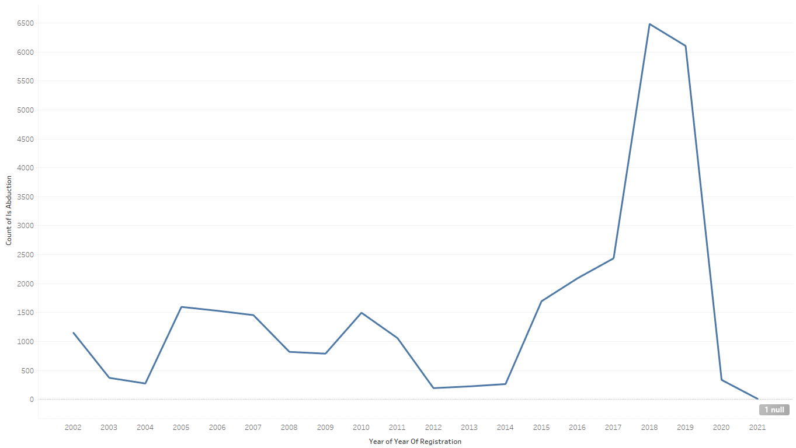
Initial Findings
We found these during the proposal and cleaning process
Overall trends suggest that trafficking volume has increased over the last 2 decades.
An observation: In 2020 Covid broke through and collecting data after that was extremely difficult

Slide 14
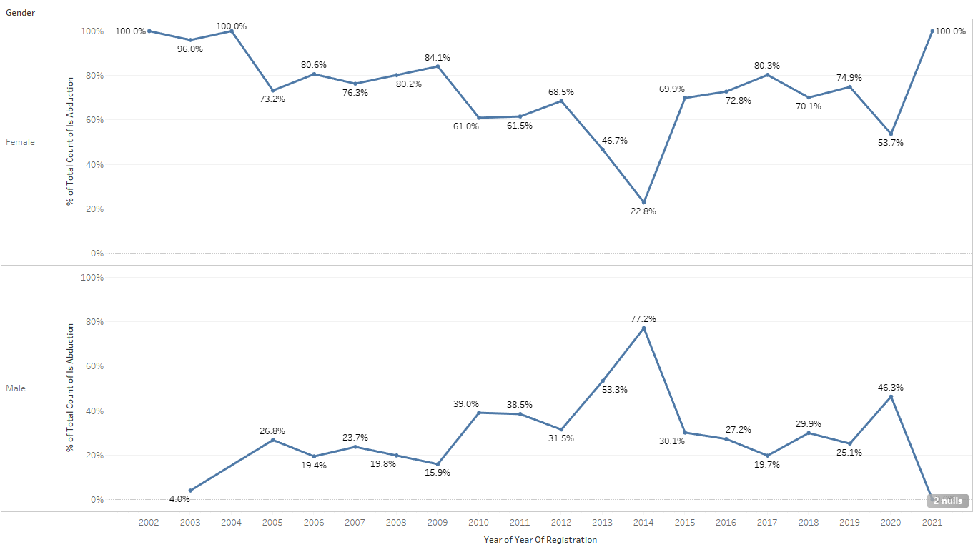
Initial Findings
We found these during the proposal and cleaning process
Over time males have comprised of a higher percentage of the total victims being trafficked.

Slide 15
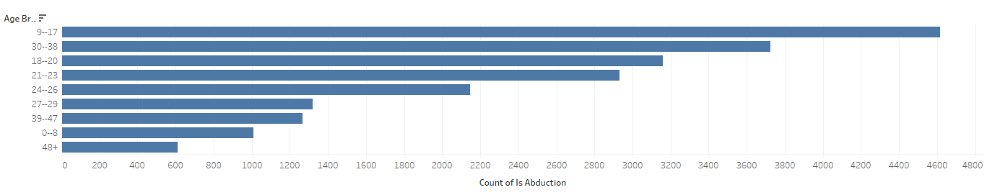
Initial Findings
We found these during the proposal and cleaning process
In terms of age distribution, younger aged people are more likely to be trafficked than older people.

Slide 16
Research
After the initial findings we decided to conduct even more research to start understanding what the experts are saying about Human Trafficking

Slide 17
Research TOP Findings
​
​
Research has shown that human trafficking is one of the fastest growing forms of transnational crime. The clandestine nature of trafficking makes it much harder to get evidence of actual trends happening worldwide. This project will attempt to create trends based on the dataset we discovered.​
Traffickers take advantage of the unequal status of women and children in disadvantaged countries and capitalize on the cheap labor and the promotion of sex labor in some countries.​
About half of all humans trafficked are under the age of 18.​
Other big populations that are at risk of being trafficked are runaways and homeless youth as these groups don’t have a strong sense of family in their normal lives. ​
Within the next 10 years human trafficking is expected to surpass drug and arms trafficking in its incidence.​
The annual revenue exchanged from human trafficking is projected to total to 32 billion US dollars.

Slide 18
WE WANT TO
PROTECT
OTHERS
We want to help to reduce or eradicate Human Trafficking as a whole.

Slide 19
THANK
YOU

Slide 20
References
​
​
Weitzer, R. (2014). New Directions in Research on Human Trafficking. The ANNALS of the American Academy of Political and Social Science, 653(1), 6–24. https://doi.org/10.1177/0002716214521562​
Clawson, Heather J., et al. "Human trafficking into and within the United States: A review of the literature." Washington, DC: Office of the Assistant Secretary for Planning and Evaluation, US Department of Human and Heath Services. Retrieved December 25 (2009): 2009.​
Wheaton, Elizabeth M., et al. “Economics of Human Trafficking.” International Migration, vol. 48, no. 4, 2010, pp. 114–141, https://doi.org/10.1111/j.1468-2435.2009.00592.x.

